Slide 1
Namas Crystal
Crystal E-commerce Platform
Team 29

Slide 2
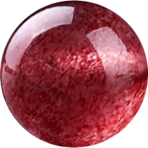
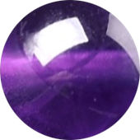
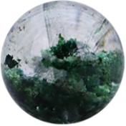
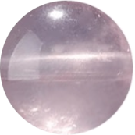
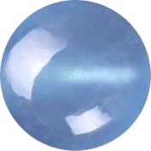

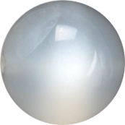
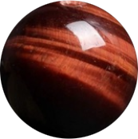
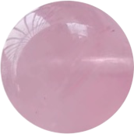
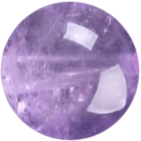

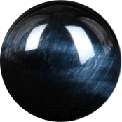
Background
Namas Crystals is a personalized e-commerce platform specializing in crystal accessories. Our goal is to blend spiritual elements with a modern shopping experience, allowing users to discover and customize crystal products tailored to their unique characteristics and preferences. Project Objectives
Seamless Shopping Experience: Enable a smooth flow from browsing to payment.
Customization Feature: Allow users to design their own crystal accessories
Personalized Recommendations: Provide crystal suggestions based on users’ personality traits and preferences.
Inspiration and Motivation
Unique Shopping Experience: In recent years, interest in spiritual well-being and personalized products has surged, with more people seeking unique items that resonate with their individuality and beliefs.
Personalized Product Discovery: Unlike traditional e-commerce sites, Namas Crystals goes beyond basic recommendations. We aim to provide a deeply personalized experience where each crystal suggestion aligns with users’ unique traits
Notes:
whether for enhancing energy, promoting relaxation, or fostering spiritual growth.

Slide 3
Technical Details
Pages:
Register + Login Page
Home Page
Item Page (Necklaces, Bracelets, Rings)
Product Detail Page
Cart Page
Payment Page
Customization Page
Navigation Bar + Footer
Other Flows:
User Management: create account, anonymous browsing, login (OAuth)
Cart Management: add item, delete item, modify quantity, checkout
Payment Management: Stripe API (Shipping address suggestion/validation, payment method management, fraud prevention)
Technical Tools:
Frontend: React (Javascript -> Typescript), Tailwind (CSS)
Backend: Django, MySQL
Optional Features:
Review after purchase
Chatbot
Collaborative customization design

Slide 4
Original Goal + Completion
Group | Function | Team Member
Home Page | Feature Image (Maybe use Slider) | Waiola
 | Design for Different Categories Find Your Crystal, New Arrivals, Best Sellers, Customize | Waiola, Jay
Item Page - Bracelets - Necklaces - Rings | Items List | Zach, Jay
 | Filter | Zach
 | Sort By | Zach
Extra Completion:
Product Detail page
Login, Registration Page

Slide 5
Demo
http://localhost:5173/

Slide 6
Next Sprint Goal
Checkout Page
Backend
Stripe API Integration
Crystal Recommendation

